Slide 1
The impacts of COVID-19 pandemic on public transit demand in the United States
Luyu Liu
2021.1.29
Notes:
Recent study

Slide 2
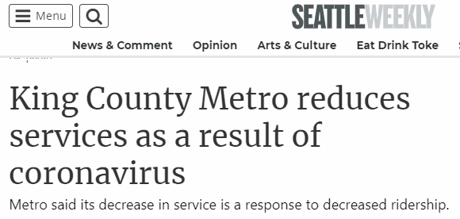
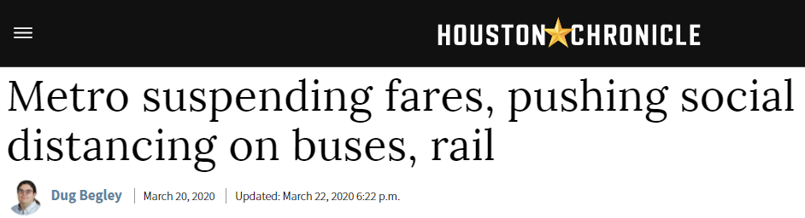
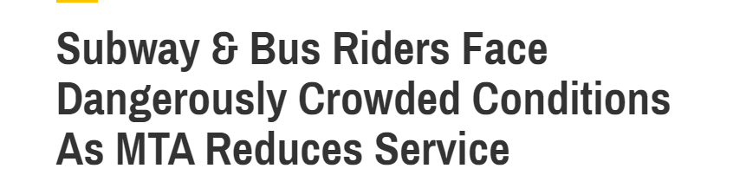
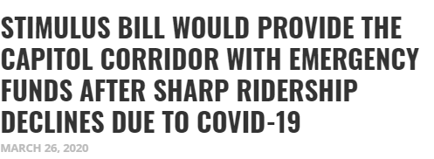
Transit in a crisis
Seattle: lost 60% of ridership
Houston: lost 29% of ridership
NYC: lost 70% of ridership
Sacramento: lost 90% - 95% of ridership
Notes:
Motivation
Different,
Why they are different

Slide 3
Research questions
How many people continue to use transit during the lockdown?
What factors were correlated to the demand?
How did ridership in different cities respond to the pandemic?
How did the pandemic reshape our commuting pattern?

Slide 4
Data source
Notes:
It is very hard to quickly get the data to finish the timely research like this paper; and we also face other issues like different standard and incompatible protocol.

Slide 5
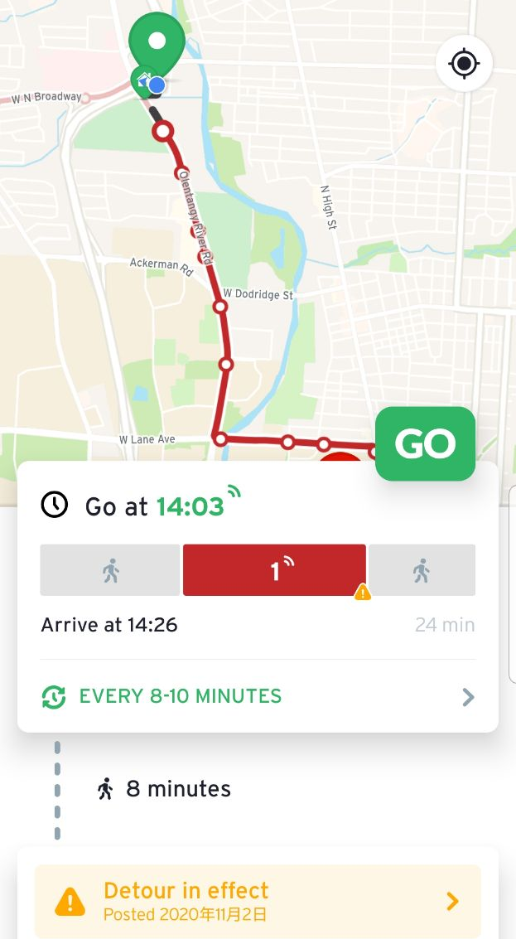
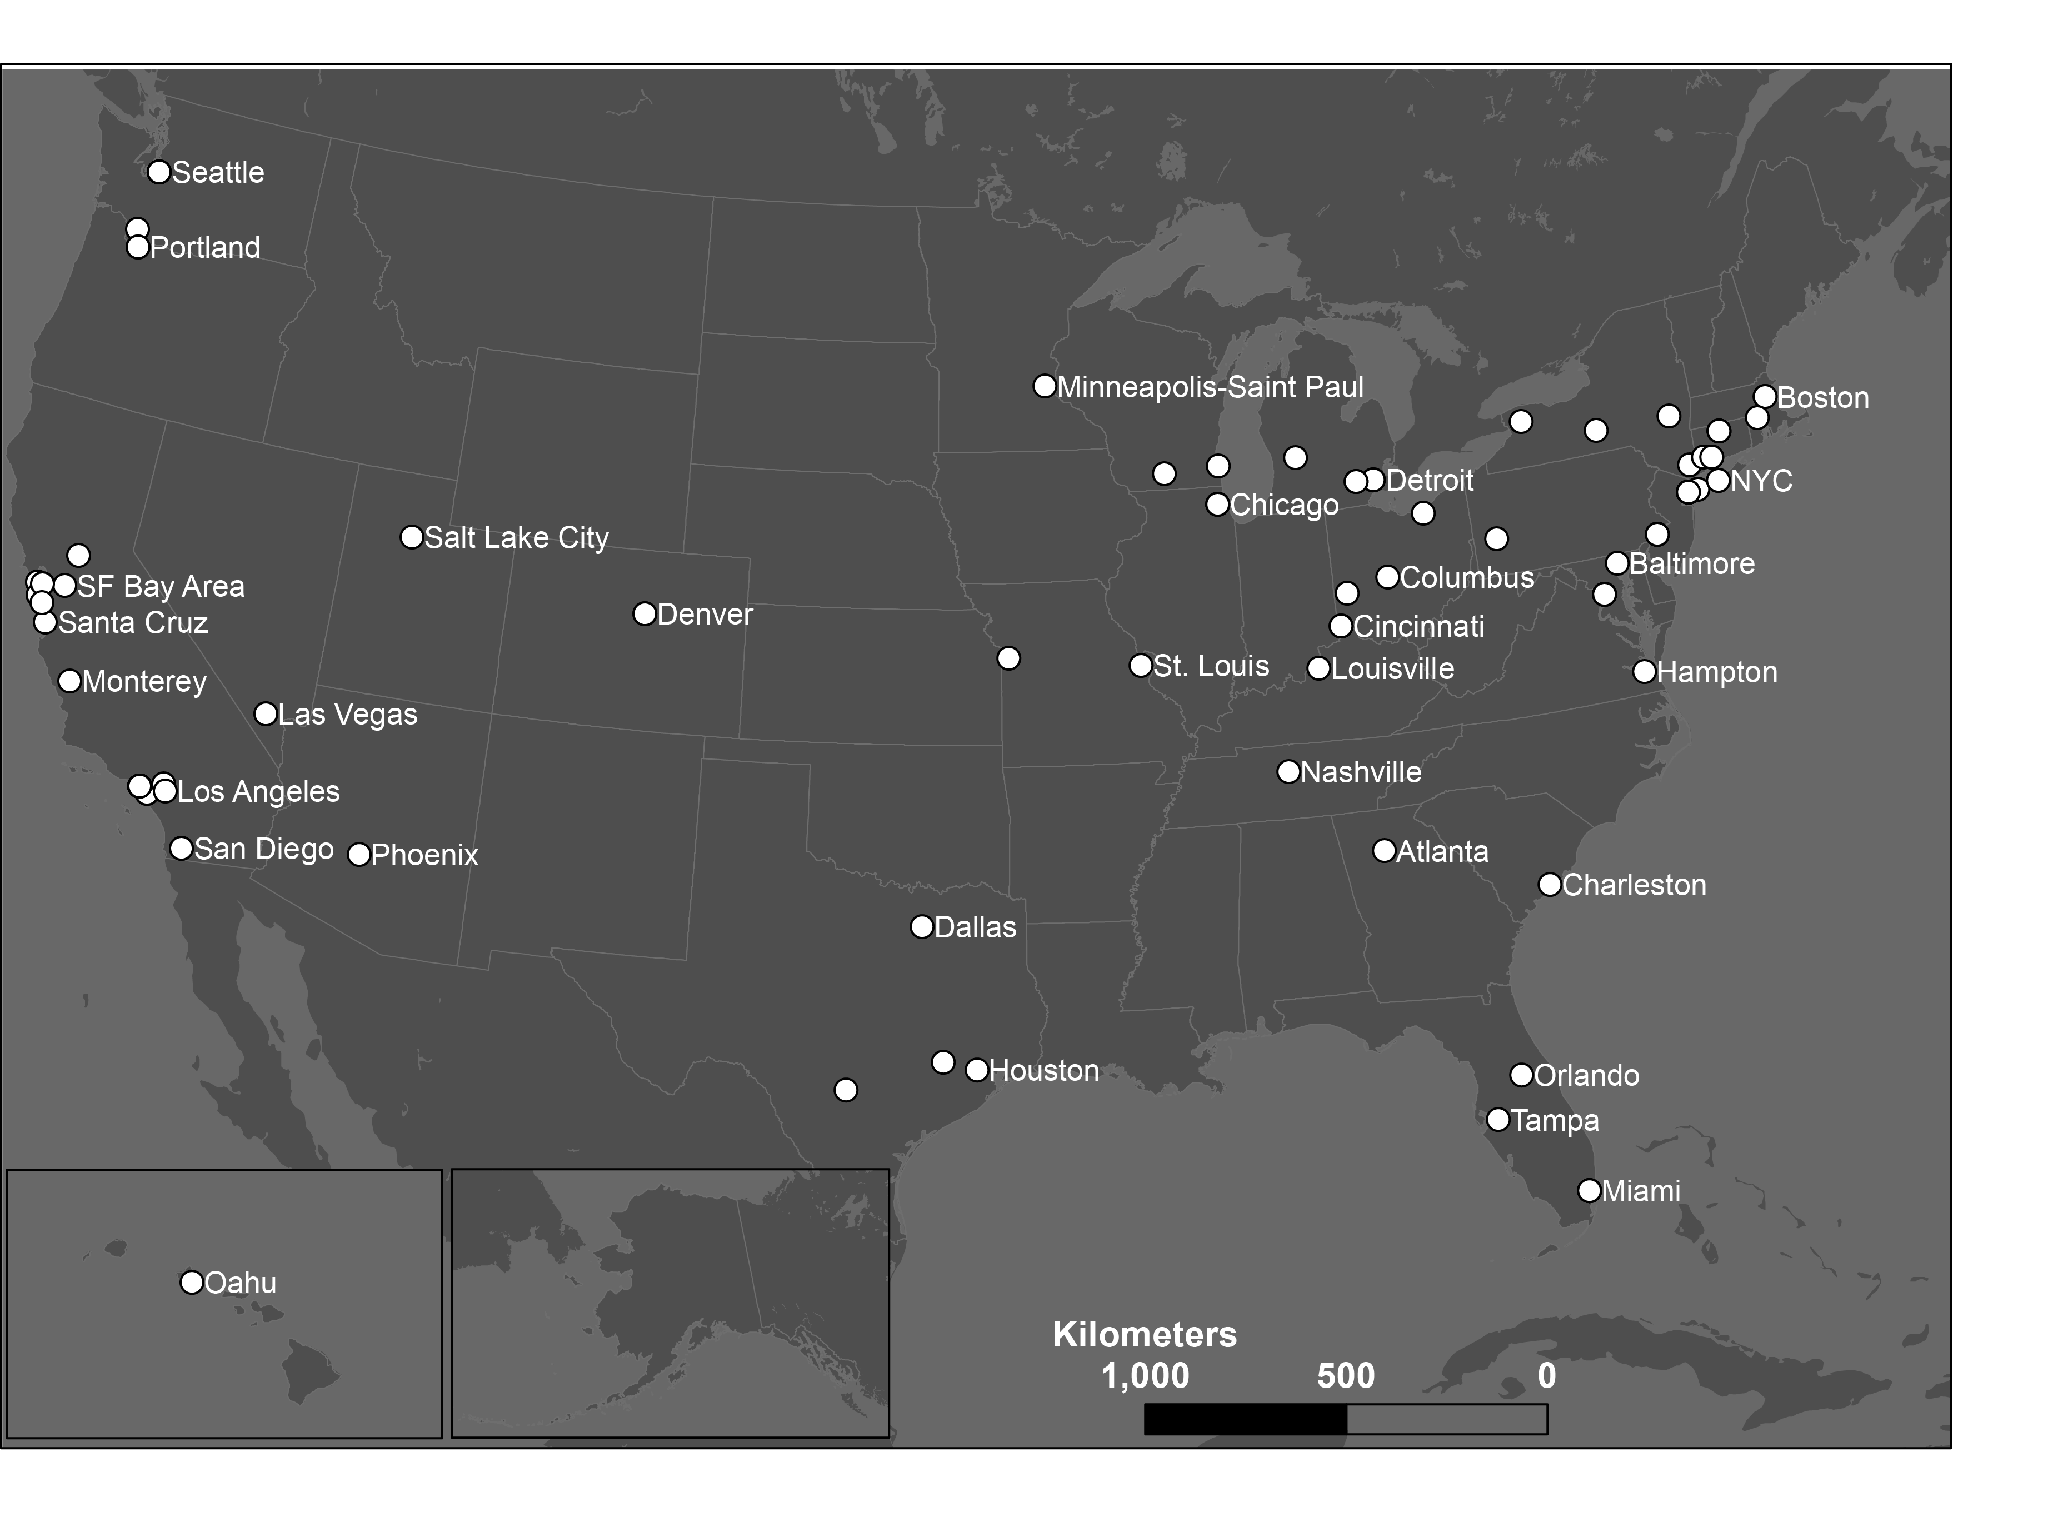
Data – Transit demand
113 county-level
transit systems
63 metro areas
28 states
Cell phone activity data from Transit app.
Notes:
We resort to a third party data set derived from cell phone app
Transit app is a very popular trip planning app. Its interface is shown in the left. It could plan your trip before you want to take the transit.

Slide 6
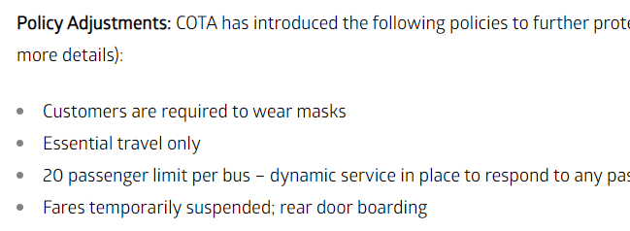
Representativeness?
Very large user base of 1 million.
Paired-t test showed no bias between official data and Transit app data.
Regular passenger count data is not accurate:
Large intrinsic error
Rear door boarding
Free riding
Notes:
Due to Policy change, regular ridreship count data cannot reflect the ridership during the pandemic.

Slide 7
Transit demand during the lockdown

Slide 8
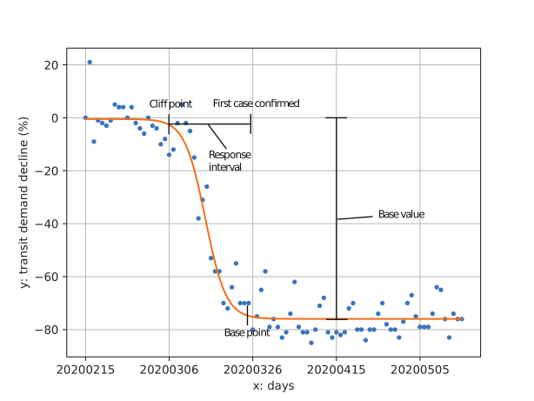
Analyze the transit decline processes
Logistic function modeling
Base value: how many people were still using transit during the lockdown
Time frame: Feb. 15th – May 17th
Transit demand decrease in Capital metro, Austin, Texas
Notes:
Do this for every 113 system

Slide 9
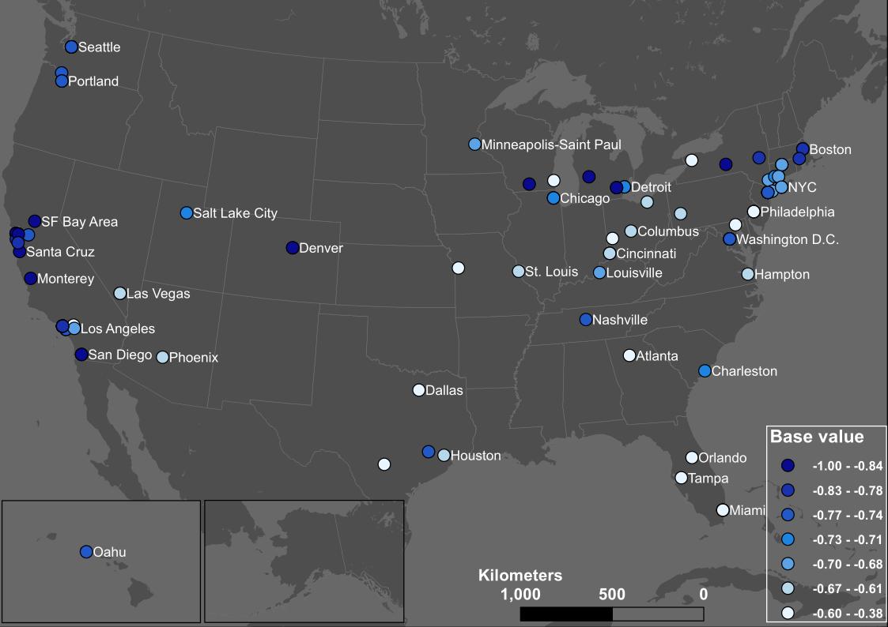
More people using transit
Fewer people using transit
Notes:
Heterogeneity; Some did not lose a lot of demand like the reports.
Regional – coastal counterintuitive; Midwest and deepsouth

Slide 10
Who were still using transit?

Slide 11
Who were still using transit - a regression analysis
Four categories of factors contribute to the base value – higher transit demand during the lockdown
From high to low R-squared increment
African-American and women
Occupation (essential jobs) and Hispanic
Age (>45 y/o)
Awareness of the pandemic (Google search index)
Notes:
Your race, your gender, your job, and your age matter more compared to your awareness.

Slide 12
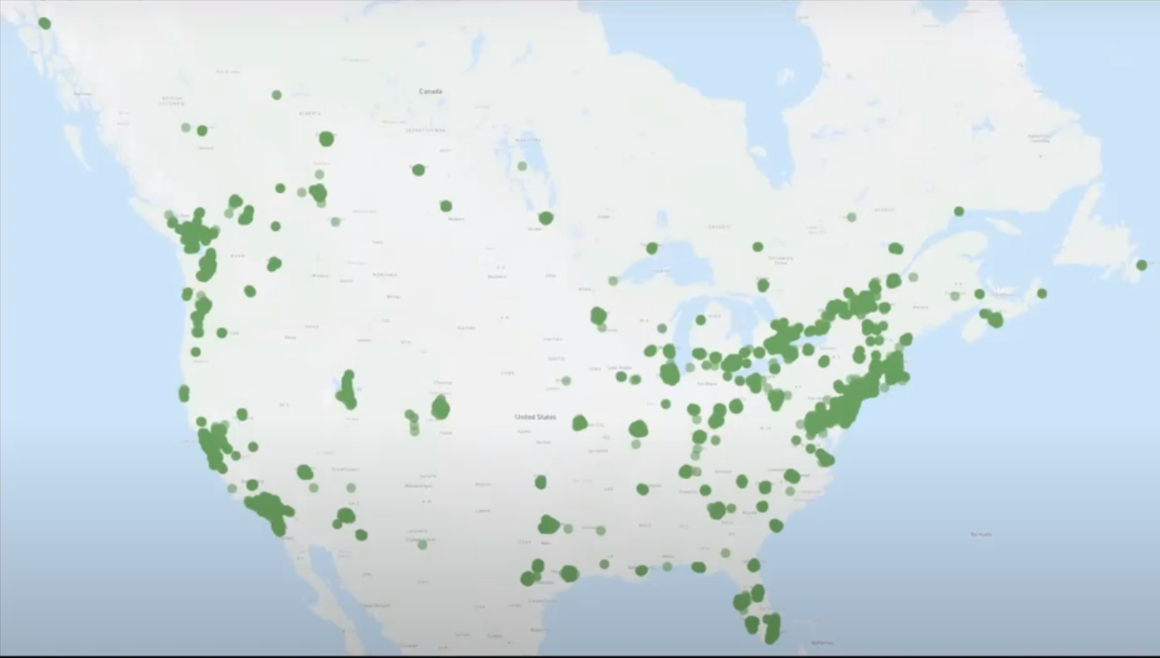
Who were still using transit - a parallel user survey
Transit app conducted a user survey (n = 25,000) on the active users during April.
Source: https://www.youtube.com/watch?v=qkT9XQtd1o4
Notes:
Quicker
In the next section, I am going to use the survwy as a first-hand proof to support some of the conclusion in our regression analysis.

Slide 13
Who were using transit – African-Americans and Women
 | Pre-COVID | COVID
African-American | 24% | 37% (+13%)
White | 41% | 23% (-18%)
Male | 50% | 40% (-10%)
Female | 50% | 56% (+6%)
https://medium.com/transit-app/whos-left-riding-public-transit-hint-it-s-not-white-people-d43695b3974a
Notes:
In some cities like Philadelphia, more than 68% of riders are women.
To be clear, this is not the absolute value. This is the proportion of different population

Slide 14
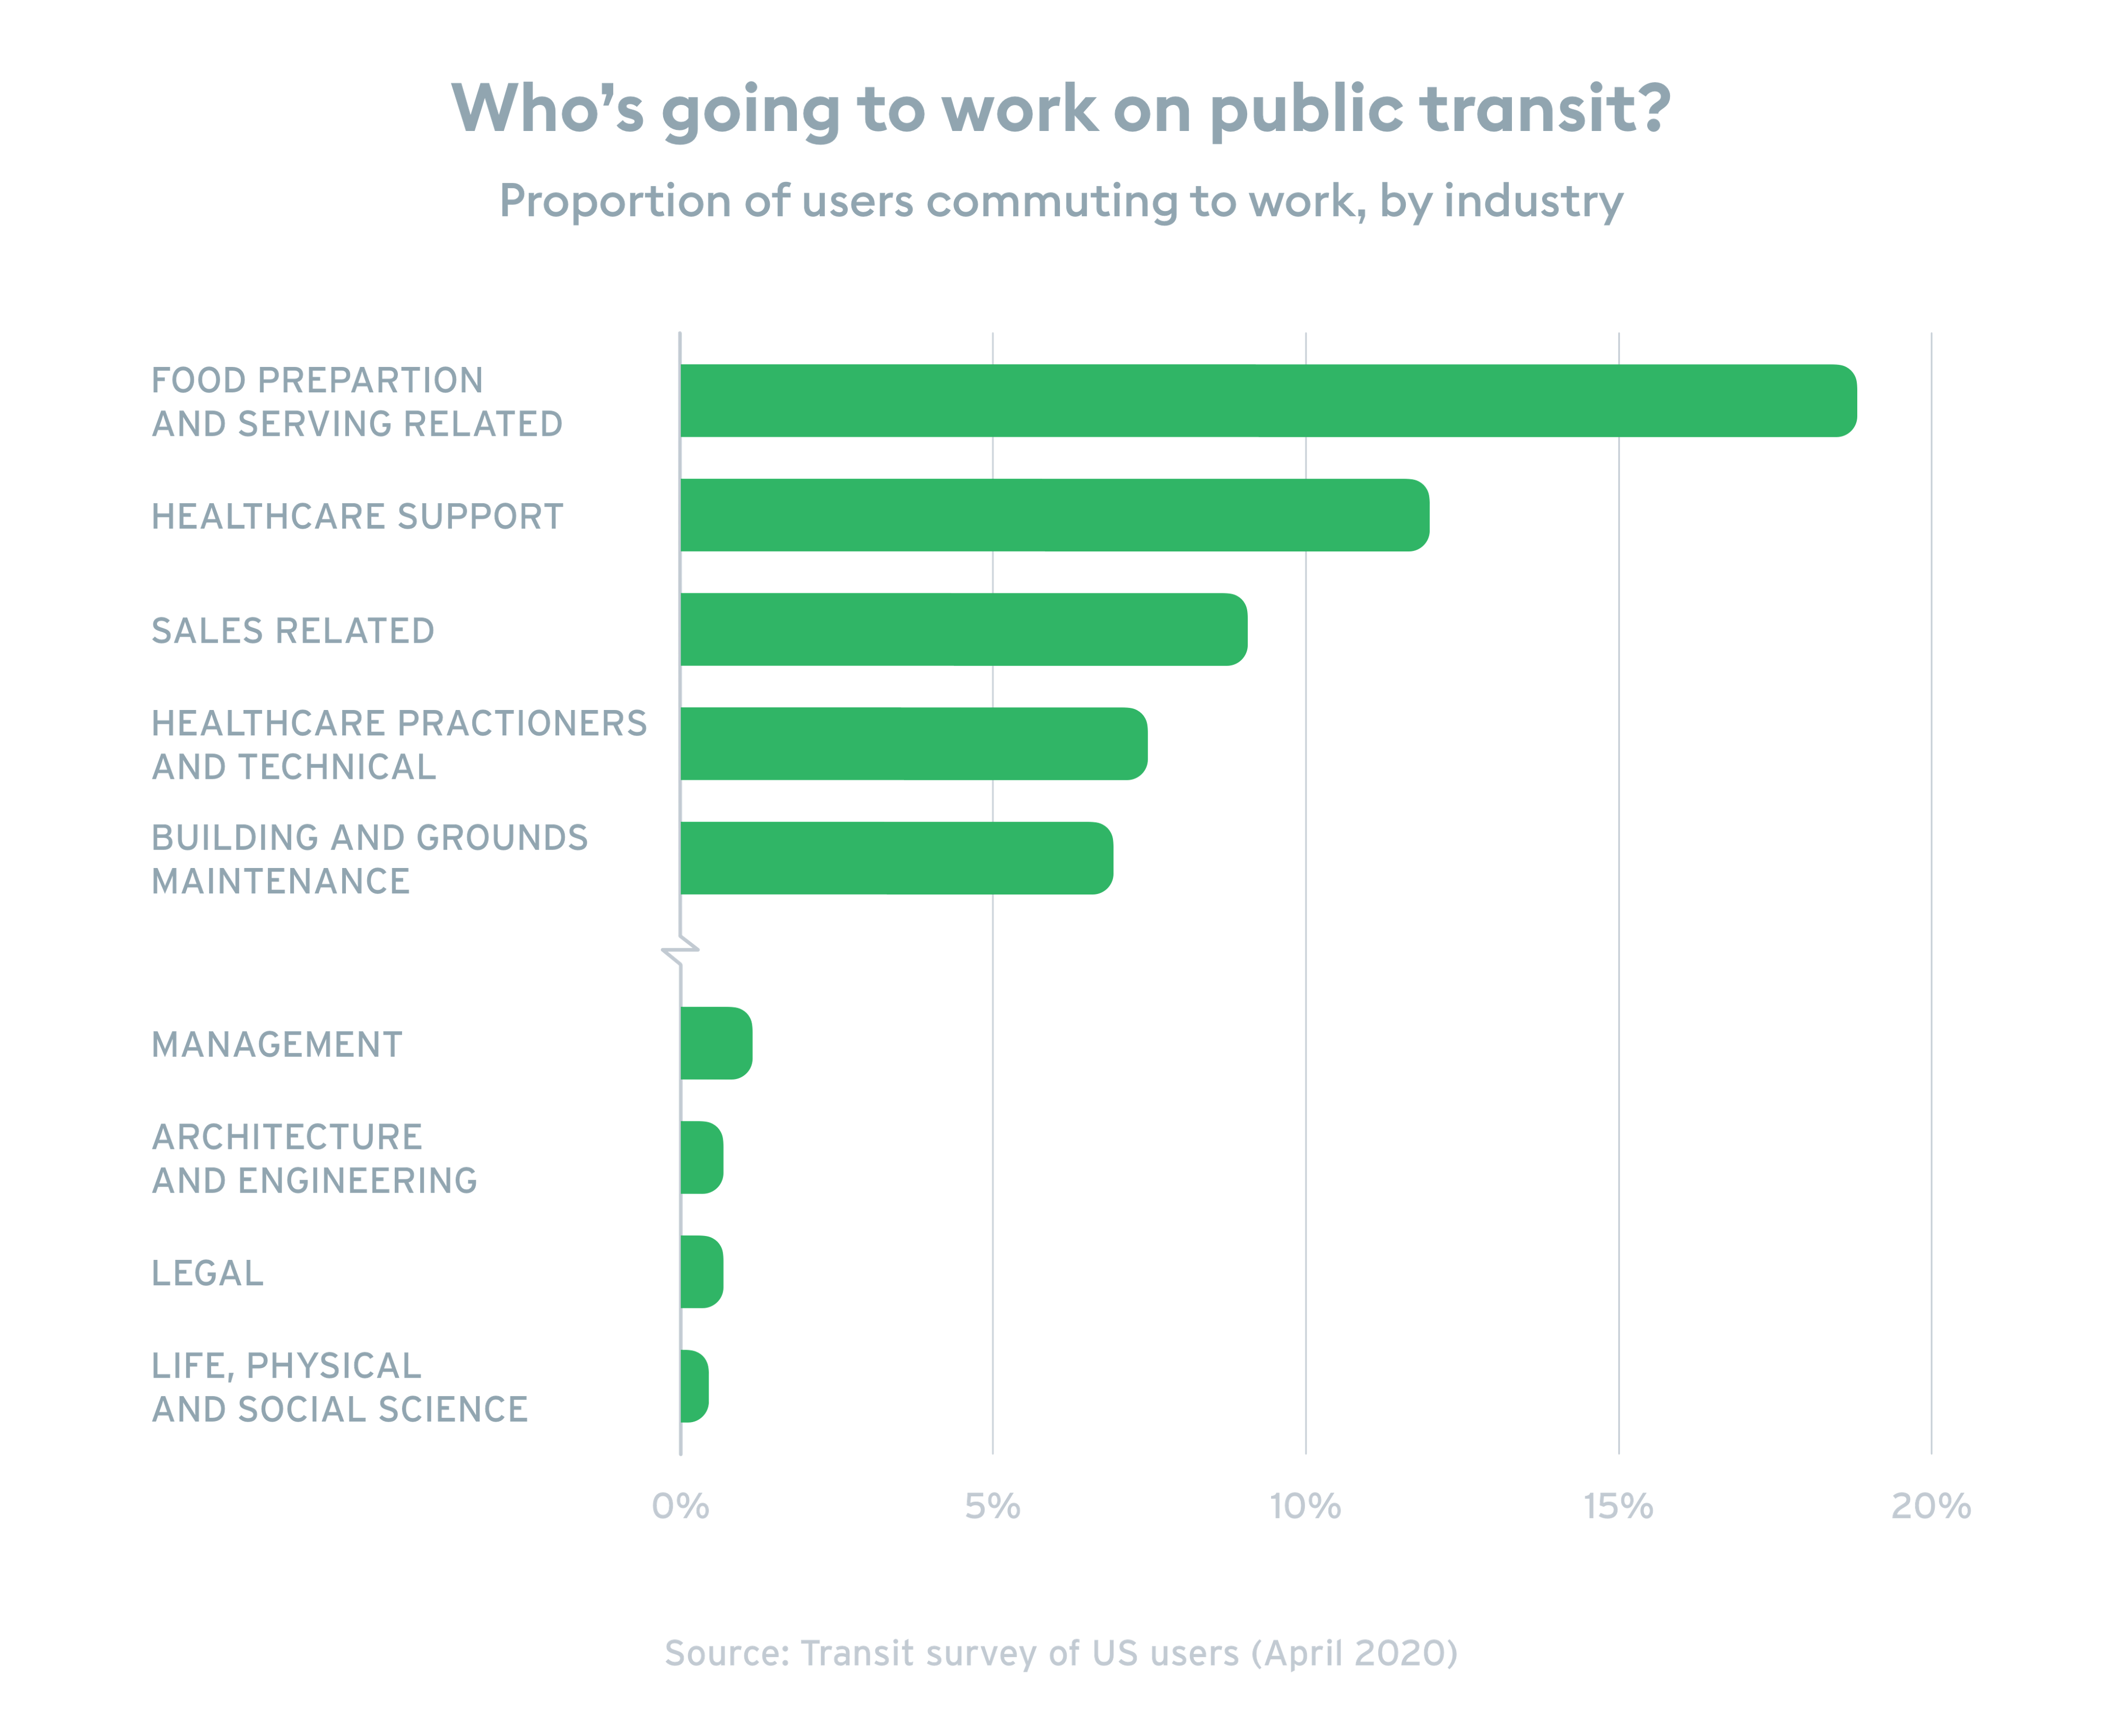
Who were using transit – Essential workers
Source: https://medium.com/transit-app/whos-left-riding-public-transit-hint-it-s-not-white-people-d43695b3974a
Notes:
And the second tier is the essential workers

Slide 15
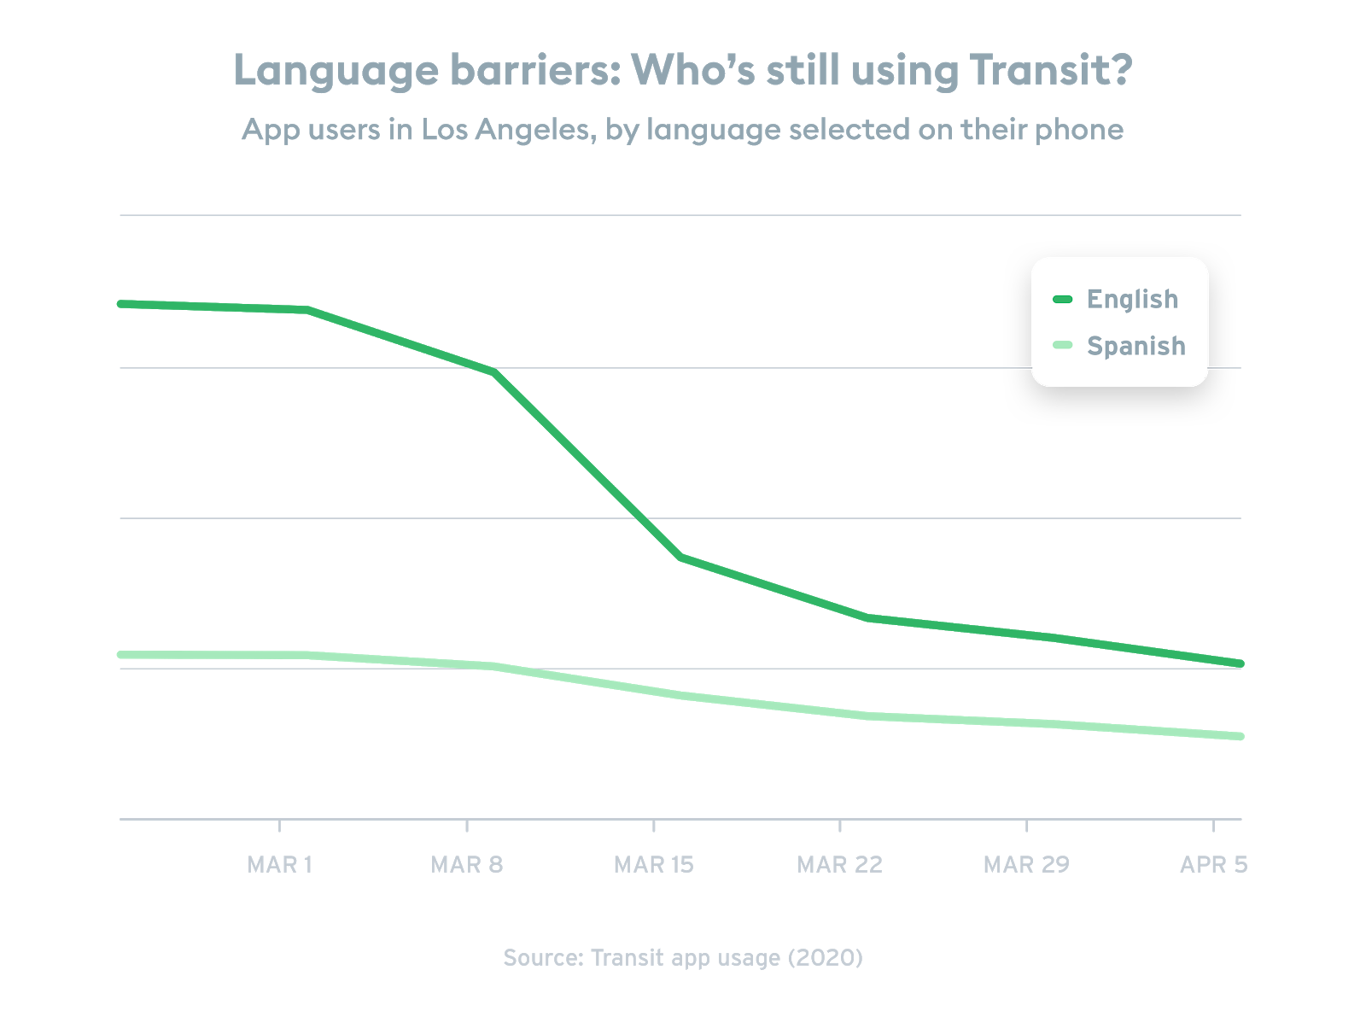
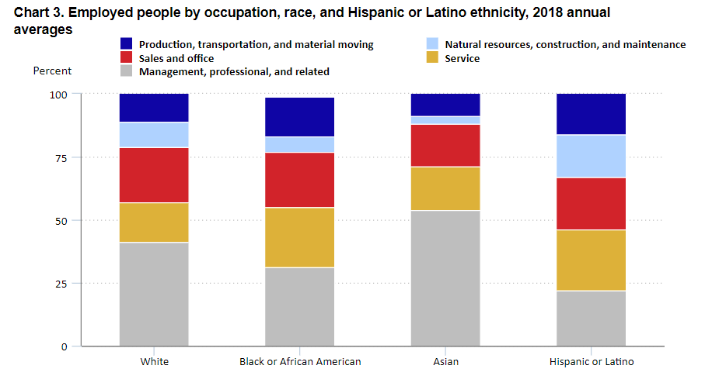
Who were using transit – Hispanic people
Hispanic people have the lowest percent to work remotely.
Source (left): https://www.bls.gov/opub/reports/race-and-ethnicity/2018/home.htm
Source (right): https://medium.com/transit-app/whos-left-riding-public-transit-hint-it-s-not-white-people-d43695b3974a
Notes:
Bureau of labor statistics.
Transit app’s survey also showed that Spanish speaking user’s ridership decreased less compared to English speaking user. In other words, if your operation system’s language is Spanish, the chance of you continue to transit is higher than those with English.

Slide 16
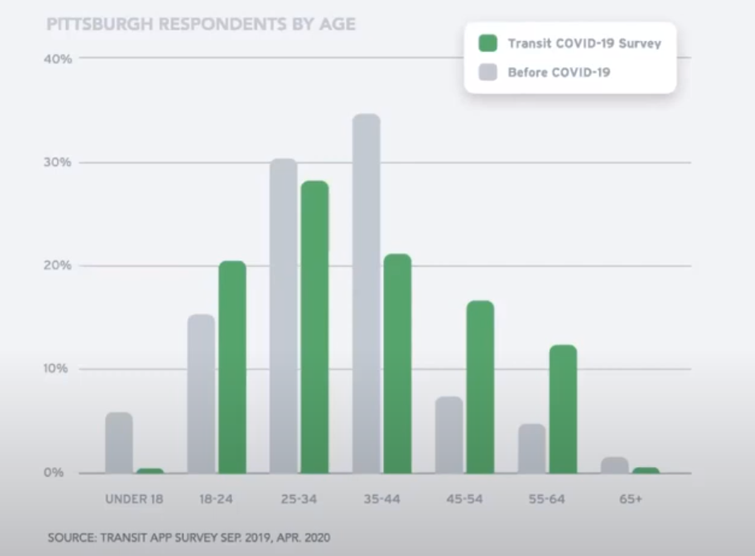
Who were using transit – seniors
Source: https://www.youtube.com/watch?v=qkT9XQtd1o4
Notes:
Despite the most vulnerable to the virus, more senior people are correlated with higher transit demand
Younger popularion, especially for people between 25 – 44 were actually taking less transit, while the proportion of older population drastically increase during the COVID-19

Slide 17
How quickly did public transit ridership respond?

Slide 18
We compared two important dates: the first day of demand decrease (cliff point) and the day of first community spread.
Response interval:
how timely did a city respond to the pandemic.
Notes:
The first important date is derived from the logistic model.
The second important date is represented by the day of first confirmed case.

Slide 19
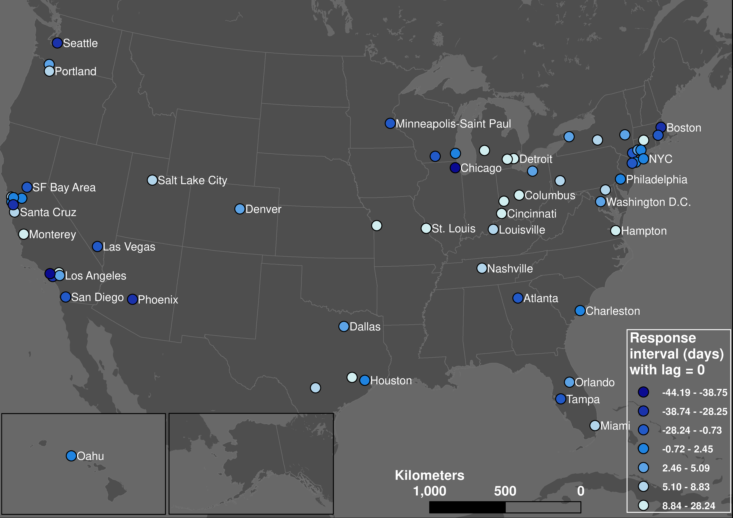
Respond earlier
Respond later
Notes:
This is very similar to the first map I showed you, especially for the Midwest part. Despite what we are right now, but we were actually the earliest region to respond to the pandemic.

Slide 20
What about incubation period?
COVID-19 has an incubation period of 5 – 14 days.
Among 113 systems:
For incubation lag = 0, 58% responded timely
For incubation lag = 5, 32% responded timely
For incubation lag = 14, only 6.2% responded timely
Notes:
I guess some of you must have been wondering why we are using the day of first confirmed case as the day of community spread. And you are right, that is not true. Way before the first case emerged, the ridership may have already been exposed to the virus. So we need to consider an incubation period. For the case of covid-19, it is 5 – 14 days. After we apply this incubation lag to the calculation again, we foundout:….

Slide 21
Policy matters
Earlier cliff point (the first day to respond) is positively correlated with earlier declaring emergency date.
Transit users’ response times are not synchronized with the evolution of the pandemic, but with the local community’s actions and policies.

Slide 22
How did the COVID-19 reshape hourly demand?

Slide 23
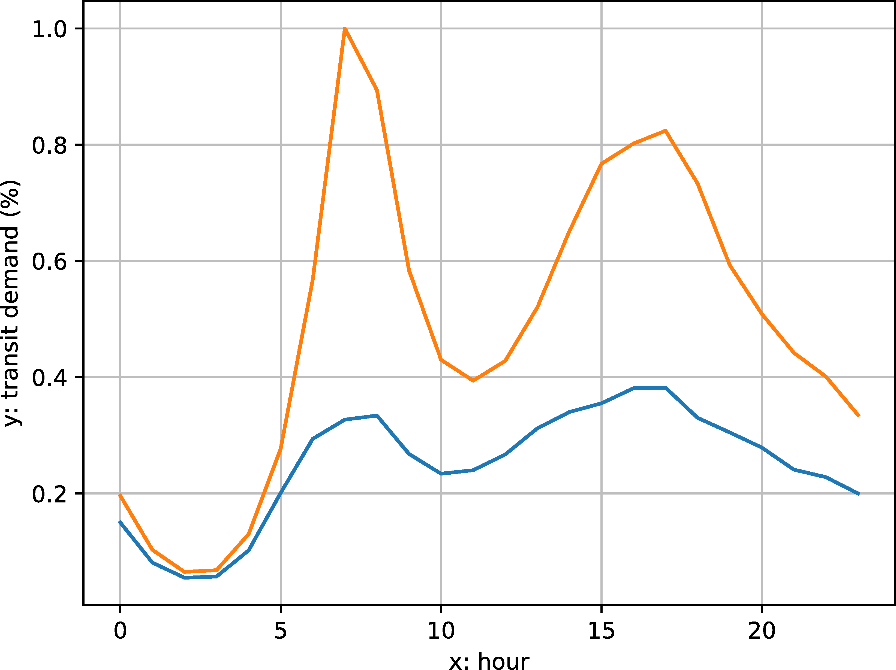
Hourly transit demand profile
MTA New York City Subway
Procrustes distance:
The similarity of shapes between the two hourly curves.
How much did hourly demand change?
Orange: before COVID; blue: during COVID
Notes:
Add Locaiton

Slide 24
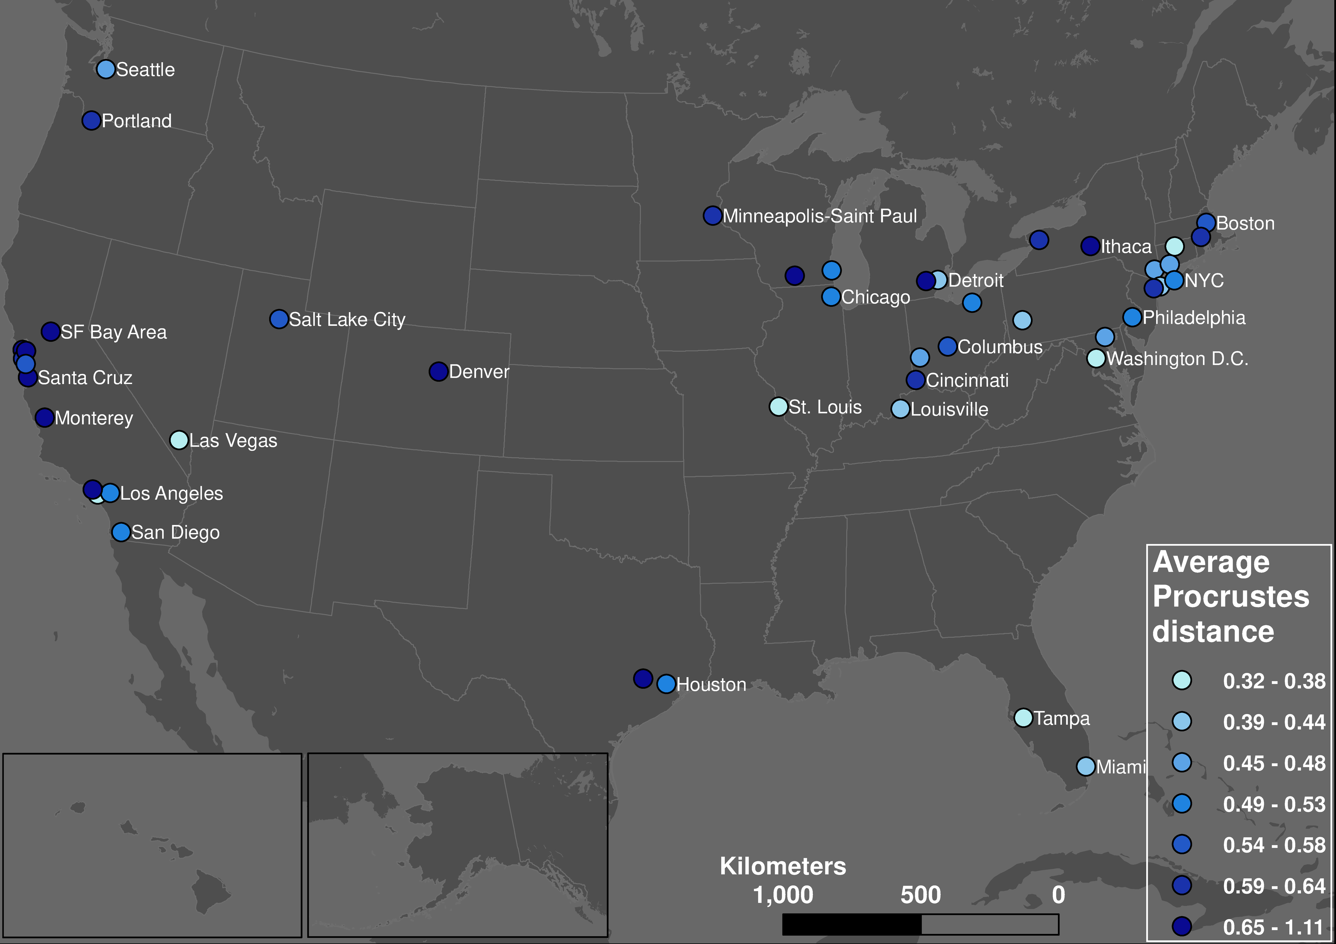
Hourly pattern changed less
Hourly pattern changed more
Notes:
As you can see, this pattern is also highly similar to the first map I presented. The florican and Midwest especially. And the usage during the COVID-19 was indeed correlated with hourly pattern change.

Slide 25
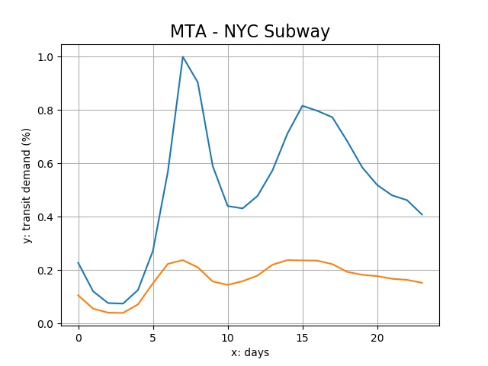
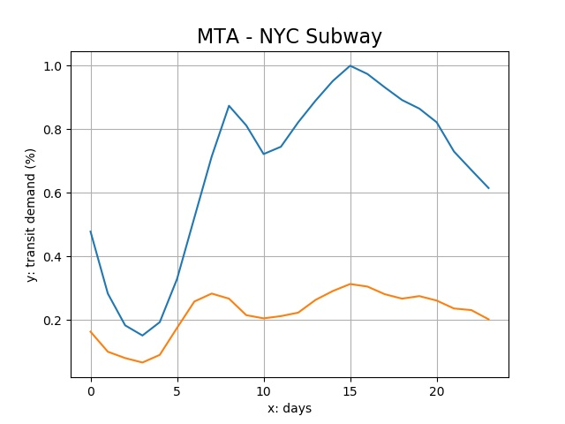
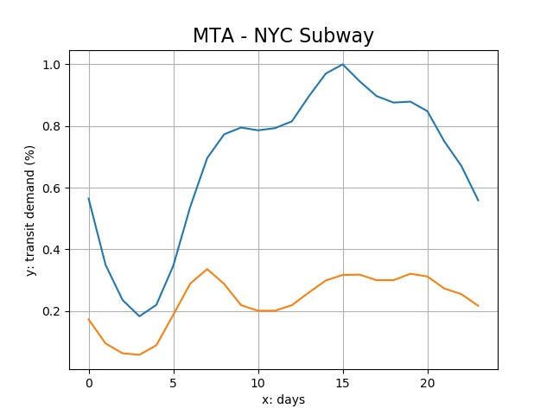
Weekday vs weekend pattern
Weekdays and weekends became more similar
Friday
Saturday
Sunday

Slide 26
What did we learn?

Slide 27
Public transit is essential
People need transit systems, even during lockdown.
These people are the vulnerable, the minorities, the poor, and the ones who have no choice.
Public transit should not be a business, but crucial urban infrastructure.

Slide 28
Rethink our response
In general, we were late.
Timely policies enacted by the local authorities did make an impact.
Mobility is not independent of public policies and economic activities.
Notes:
There is a Silver lining that despite the chaotic situation in the federal level, local community’s policy did make an impact.

Slide 29
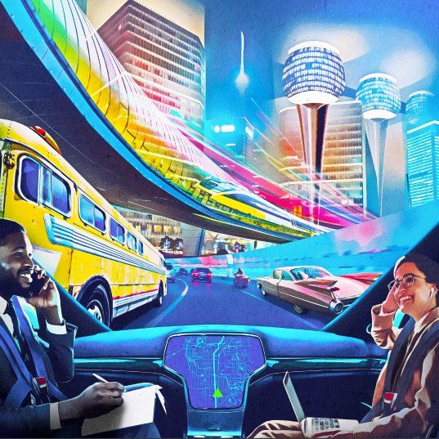
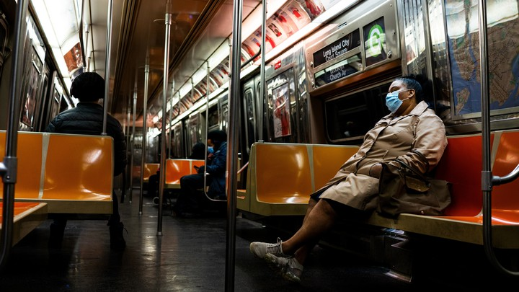
Rethink our future
What is our vision of a more equitable mobility?
Who should we subsidize? Flying cars or essential workers.
Source: https://www.transportation.gov/sites/dot.gov/files/2021-01/USDOT_AVCP.pdf
https://www.theatlantic.com/ideas/archive/2020/12/public-transit-has-come-back/617435/
Notes:
I will say flying cars are indeed tempting and I am also interested in the technology innovations (if you know me in the past and what I did). However, let us not be lured by this beautiful futuristic vision that may not benefit the public in decades; instead, let us focus on the dark and ugly reality, where our essential workers and minorities are risking losing their job because we do not have money to support the public transit system.
Below are two graphs and these two graphs are not two random graph. The left is the cover of US department of transportation’s promotion material about the self-driving cars. It promises us a bright and beautiful vision that all the people with suits and Rolex watch sit in a wide car with smile (and one of them is black so that is definitely equitable). But to the right what we see is the reality. Our transit sytesm is not okay and crying for financial and policy support.

Slide 30
Thanks!
liu.6544@osu.edu
Paper:
Liu, L., Miller, H.J. and Scheff, J. (2020) “The impacts of COVID-19 pandemic on public transit demand in the United States,” PLOS ONE 15(11): e0242476.
Notes:
Add Paper reference:

Slide 31
Data representativeness
Cell phone ownership rate of US adults is 96% and 81% for smartphone as of Feb 2019.
 | Cell phone | Smartphone
Total | 96% | 81%
Women | 95% | 79%
African-Americans | 98% | 80%
Hispanic | 96% | 79%
Less than $30000 | 95% | 71%

Slide 32
Implications of underestimating
With the data sample skewed to the privileged population, the underprivileged population are still significant in the model.
If more underprivileged population were added, it would only make the model and the conclusions more significant.
More local-level research will better answer the questions.

